Slide 1
FINE TUNING BART TRANSFORMER FOR TEXT SUMMARIZATION
JATINPREET SINGH
AARUSHI SINGH
AVNEET SINGH OBEROI

Slide 2
AIM
The aim of this research is to investigate underexplored areas in fine tuning of BART Transformers. Specifically, the goal is to enhance the quality and efficiency of text summarization by fine-tuning BART models through experimentation with various hyperparameters, training configurations, and evaluation techniques. The research aims to contribute to advancements in natural language processing techniques, particularly in the domain of summarization, and to provide insights and best practices for leveraging BART transformers effectively in text summarization applications.

Slide 3
PROBLEM STATEMENT
The problem addressed in this research is the need for improved text summarization techniques. Traditional methods often struggle with capturing context and generating concise summaries. Our work focuses on fine-tuning BART transformers, aiming to optimize their performance for summarization tasks. By experimenting with different configurations and strategies, we aim to enhance summarization quality and coherence, addressing key challenges in content extraction and information synthesis.

Slide 4
SCOPE
The scope of this research project is focused on optimizing BART transformers for text summarization tasks. This includes exploring fine-tuning strategies, evaluating model performance using standard metrics, working with datasets like XSum, and considering potential applications in various domains. The aim is to contribute to advancements in text summarization techniques and improve the quality of generated summaries using BART transformers.

Slide 5
GAP
The gap in this research project lies in the need to optimize BART transformers specifically for text summarization tasks. While BART transformers show promise in natural language processing, their fine-tuning configurations and strategies for summarization applications are still relatively underexplored. This research aims to bridge this gap by conducting experiments and evaluations to determine the most effective fine-tuning techniques for BART transformers in generating accurate, coherent, and contextually relevant summaries.

Slide 6
WORKING MECHANISM
The working mechanism of this project involves fine-tuning a pre-trained BART transformer model for text summarization tasks. This includes preparing and cleaning the data, selecting suitable hyperparameters, training the model using the prepared dataset, evaluating its performance using standard metrics, and analyzing the results. The aim is to optimize the BART model's ability to generate accurate and coherent summaries by experimenting with different fine-tuning strategies and configurations.

Slide 7
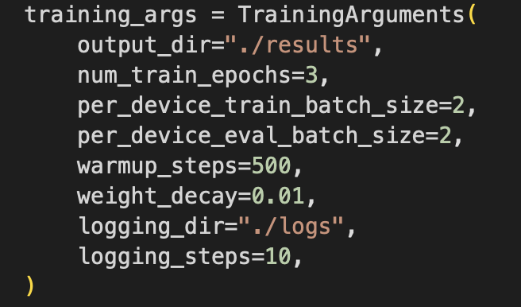
RESULTS

Slide 8
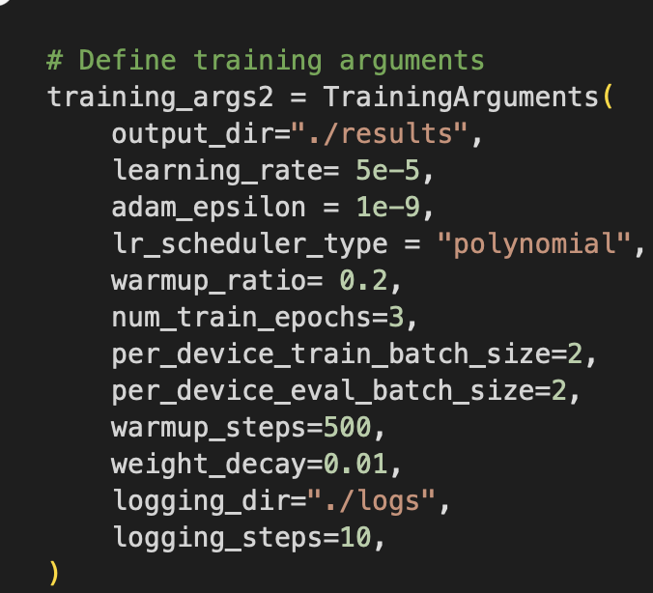
RESULTS

Slide 9
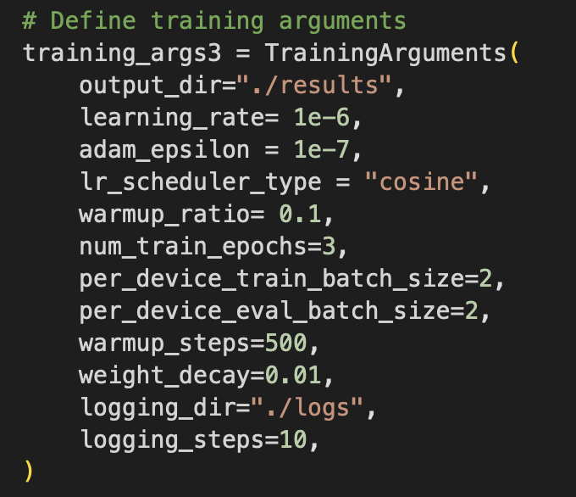
RESULTS

Slide 10
RESULTS OF OUR FINE TUNING

Slide 11
FUTURE PROSPECTS
The future aspects of this project include exploring advanced fine-tuning techniques, improving model interpretability, enhancing scalability and efficiency, applying BART models to domain-specific tasks, enabling interactive and personalized summarization experiences, addressing ethical considerations, and exploring collaborative and multi-modal summarization approaches. These avenues of exploration aim to further enhance the capabilities of BART transformers in text summarization and contribute to the ongoing advancements in natural language processing.

